Slide 1


Fleming Street/Murry Street
Septic Tank Elimination Program (STEP)
Project Public Information
2023

Slide 2
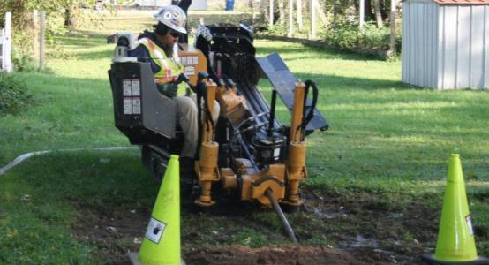

Presentation Overview
Septic Tank Elimination Program (STEP) Overview
  Program Background
  Program History
  Current Installation Program
Enrollment/Payment Options
  Enrolling vs. Not Enrolling
Project Specific Information
Additional Resources

Slide 3
Why STEP?
The Problem:
  Currently thousands of homes in Indianapolis are served by private septic systems
  Septic systems are effective wastewater disposal systems, when used in the correct environment and maintained; however, they pose a health and environmental risk when they fail or are not maintained properly
  Indianapolis’ soil is primarily a dense, non-porous clay that can become oversaturated easily, which can restrict a septic system’s ability to drain properly in smaller lots (i.e. < 1 acre)

Slide 4
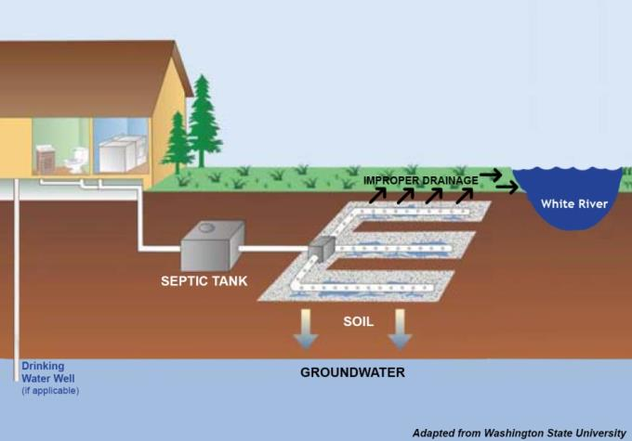
Why STEP?
The Problem:
  When septic systems fail, sewage works its way to the surface and begins to pool, creating a public health hazard
    When sewage pools, private drinking water wells are at a higher risk for contamination
  When it rains, the raw sewage pool is then able to run off into the streams and ditches throughout the neighborhood, thus polluting large areas very quickly

Slide 5
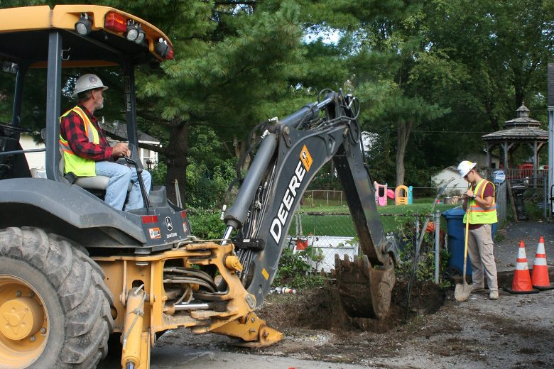
Why STEP?
The Solution:
  STEP is intended to improve water quality by connecting neighborhoods currently served by septic systems to the sewer system
  This program helps support achievement of Citizens’ federally mandated Consent Decree

Slide 6
STEP Project Identification
How was your neighborhood selected for a STEP project?
  To identify STEP areas, Citizens uses a project prioritization methodology that involves three criteria outlined below:
    Housing density
    Proximity to a floodplain
    Presence of residential drinking water wells
  This neighborhood scored very highly on the priority list

Slide 7
STEP Project Identification
Housing density
  Housing Density involves how close properties are to one another. A smaller property (< 1 acre) means less space for septic systems to function as designed. It also means more septic systems attempting to function in proximity, thus leading to shorter life spans. Further complicating things, smaller properties provide little to no extra room to replace a septic system, making repair options limited and expensive.
Proximity to a floodplain
  When septic systems fail, raw sewage is typically present on the ground surface. Anytime there is rain or flooding, an area’s proximity to a floodplain can allow for that raw sewage to spread out and pollute a large area very quickly.
Presence of residential drinking water wells
  If raw sewage is present on the ground surface, your drinking water well is more likely to become contaminated.

Slide 8
History of STEP
STEP has been around for a long time, but in 2016, Citizens significantly revised the program to be more customer service oriented and more cost effective.
2005 – STEP is formalized under City of Indianapolis
2011 – Citizens acquires wastewater assets from City of Indianapolis (including STEP)
2016 – Citizens remodels STEP into new program
Old Program
New Program

Slide 9
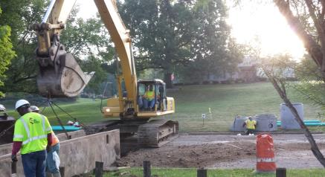
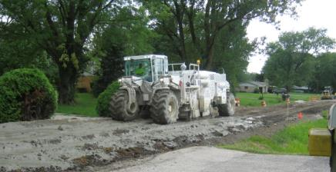
History of STEP
Old STEP (Pre-2016)
  Format no longer used
  Gravity sewers were installed
    Large open trenches, very messy and disruptive, extremely expensive
  Property owner responsible for hiring a contractor to construct their lateral, obtain proper permits, connect to sewer, and abandon the septic tank
  Total property owner cost: $3,000 – $10,000+
    Financial Assistance Plan (FAP) based on need

Slide 10
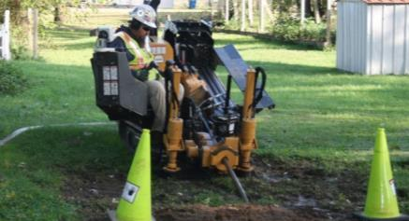
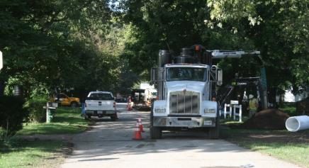
History of STEP
STEP Today (2016-Today)
  Format currently used
  Low Pressure Sewers are installed
    Horizontal directional drill installation, minimally intrusive, cost effective
  Citizens connects each property owner who enrolls in project by deadline (optional)
    Installs all components of a low-pressure system in the public right-of-way, perform all work on property and connect to the sewer system, abandon septic tank, and restore yard
  Total property owner cost: $2,739
    Plus any applicable plumbing or electrical modifications

Slide 11
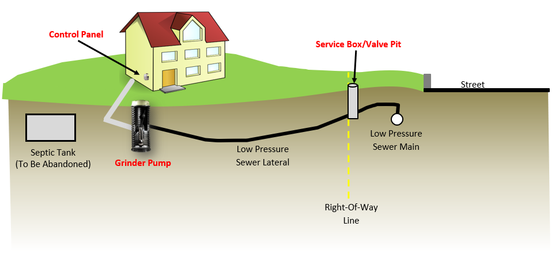
What is a Low-Pressure Sewer?
Sewer that uses a pump at each connection to force wastewater through small diameter pipes
Three major components:
  Grinder Pump
  Control Panel
  Service Box/Valve Pit

Slide 12
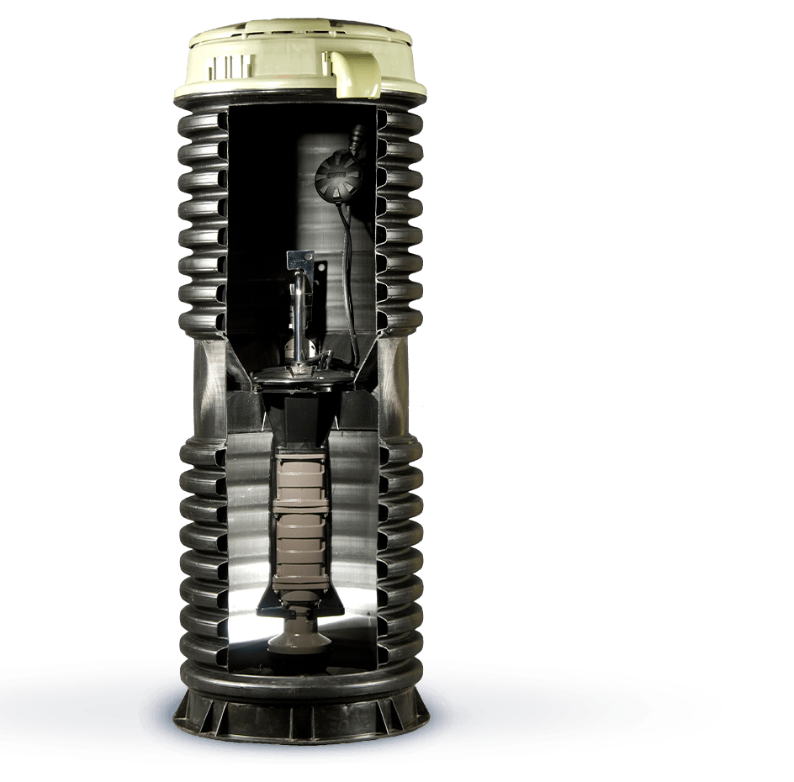
Grinder Pump
Ground Level
Pump provides the pressure needed for the low-pressure sewer to function
Pump is housed inside a large basin with 70 gallons of storage capacity
  E/One grinder pumps will be used
  Pump is similar to an industrial garbage disposal in that you should not flush or put anything down the drain that you would not normally put down a garbage disposal
Pump is controlled by the Control Panel
Sump pumps cannot be connected, per Section 201.03 of the Sanitary Sewer Standards, and must be separated by property owner prior to grinder pump installation
Flow out
Flow In
Normal Operating Range
Pictured above: E/One Grinder Pump Section View

Slide 13
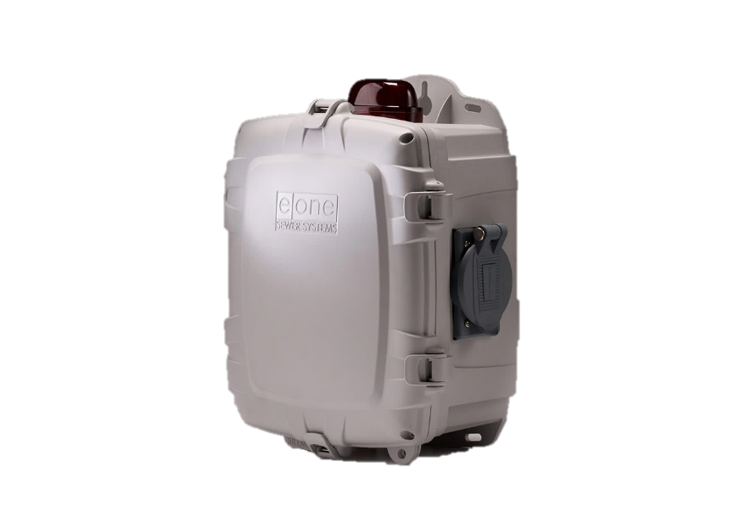
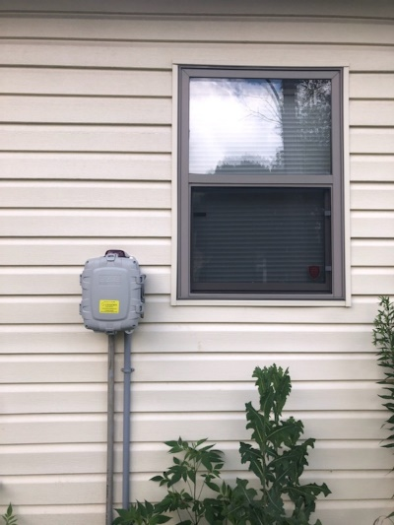
Control Panel
Tells the pump when to turn on, turn off, and if there are problems
  Visual and Audio alarm if pump issue occurs
Runs on electricity
  Grinder pump will not run during power outage without secondary power
    Generator receptacle included on each control panel
    Most water-producing appliances will not be powered, thus not producing additional water. Used water will be stored in the tank until power is restored.
  Requires property to have a minimum 100-amp main electrical panel with room for a 30-amp double breaker
  240-volt wire is included with grinder pump
Pictured above: Control Panel with Generator Receptacle
Pictured below: Installed Control Panel

Slide 14
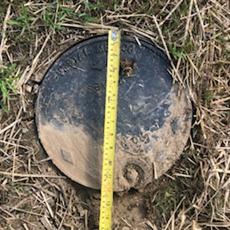
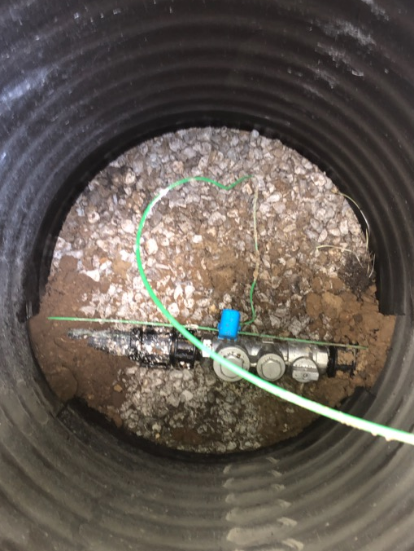
Service Box/Valve Pit
Installed on the right-of-way line
Houses a shut off valve and check valve
Looks very similar to a water meter pit
Provides a visual marker for the separation line for ownership and responsibility once the system is installed
  Property Ownership and Responsibility: Service Box to the house
  Citizens Energy Group Ownership and Responsibility: Service Box to the sewer main
Pictured above: Service Box/Valve Pit Lid
Pictured below: Inside of Service Box/Valve Pit
Ball valve and check valve

Slide 15
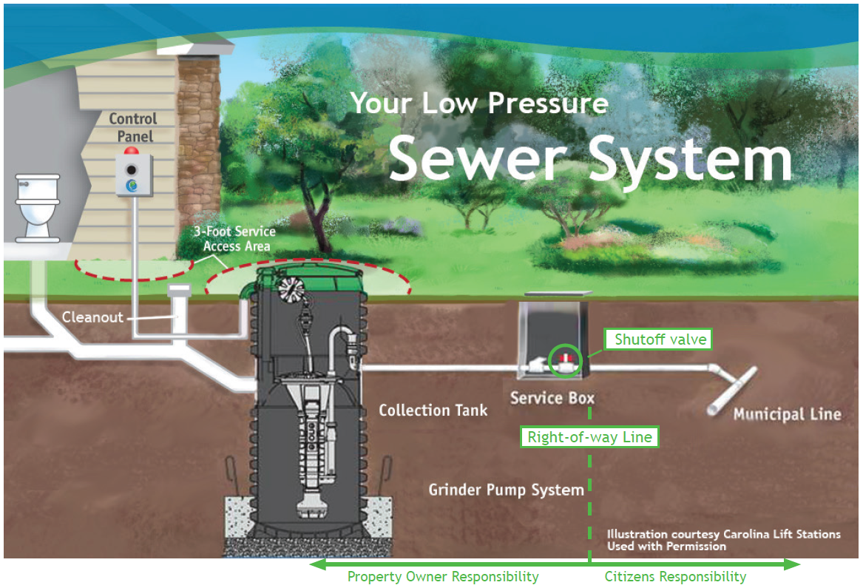
Low Pressure Sewer Overview
Property owners are responsible for operating and maintaining all components from the service box to the house once installed
Grinder pump is equivalent to a major appliance, like an air conditioner or furnace
  Will require service calls over time and eventual replacement
  Comes with a three-year warranty
Answers to frequently asked questions can be found in the STEP Program Guide and the Owners Guide

Slide 16
Am I Required to Connect?
Homeowners are not required to connect if septic tanks are in healthy and functional condition. However, if a septic tank fails and a permit cannot be obtained for a replacement, homeowners will then be required to connect.
The benefit of connecting now is cost sharing with Citizens – it will cost more to connect later if not included during STEP.

Slide 17
Am I Required to Connect?
Citizens Energy Group (Citizens)
  Constructs sewers and oversees the Installation Program and Enrollment Agreement
  Does not have the authority to require property owners to connect to the sewer; however, Citizens does provide a financial incentive to participate now, rather than waiting on the Marion County Health Department (MCHD) to enforce the connection
    If a property owner does not enroll by the dates listed in the STEP Enrollment Agreement, that property owner will be responsible for connecting the properties themselves independently when the MCHD enforces the connection
    Connecting independently involves paying the $2,739 Connection and Permit Fee in lump sum, hiring a licensed contractor, abandoning the existing septic system, installing and purchasing your own grinder pump, control panel, and any necessary materials (valve pit, lateral, etc.) that comply with Citizens’ Sanitary Standards
    In total, property owners can expect to pay anywhere from $9,000 to $15,000+ with no monthly payment plans available through Citizens when connecting independently

Slide 18
How to Enroll
Sign STEP Enrollment Agreement*
  All deeded owners must sign
  Allows access to property/house for defined scope of work with a right-of-entry
  Payment option selection (next slide)
  Commits property owner to connect to the sewer system
Fill out the property questionnaire to the best of your ability
Return using the Business Reply envelope provided in your packet OR email the forms to the project manager (email listed on last slide)
* Must enroll by dates listed in the STEP Enrollment Agreement. Additional charges and ineligibility may apply after that date.

Slide 19
Payment Options
STEP Enrollment Cost: $2,739
  Lump sum, or
  Pay over 60 months (5 years) with no interest
      $45.65/month
      All property owners are eligible
  Will be included on monthly Citizens bill (Rates can be found at: www.CitizensEnergyGroup.com/My-Home/Rates-Regulatory-Notices)
Any plumbing or electrical modification is the responsibility of the property owner

Slide 20
Important Information About the Loan Option
If you choose the loan option in section C of the Enrollment Agreement, please note the following:
The STEP Enrollment Agreement is a binding contract between you and Citizens.
You are responsible for repayment of the loan even if you sell the home (see Assignment Section of Agreement).
Failure to repay the loan can result in disconnection of your sewer and/or water service.

Slide 21


Fleming Street/Murry Street STEP Project Information
Design/Build Team
  TSW Utility Solutions, Inc.
  7NT Engineering, Inc.
Anticipated Schedule
  Winter 2023-Spring 2023
Estimated Project Cost
  $385,000

Slide 22
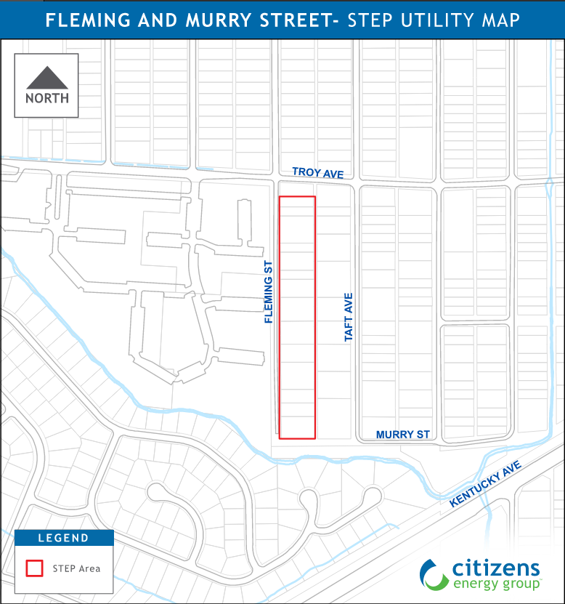
Project Area Map
Residents will receive program/project background information and STEP enrollment agreements in Fall 2022
Residents will be contacted by the project team about their specific septic tank in Winter 2023

Slide 23
General Project Timeline
(from property owner’s perspective)
STEP Enrollment Agreement is signed and submitted to Citizens Energy Group
Any needed plumbing or electrical modifications are completed by property owner
Control Panel, lateral, and service box/valve pit are installed
Grinder Pump is installed and septic tank is abandoned
Property restoration occurs
Contractor and/or Covalen will meet with property owner to go over grinder pump placement and determine if plumbing or electrical modifications are needed

Slide 24

Project Stages
During construction
  Contractor will notify property owners in advance of any work taking place on private property
  Roads will be open and passable
    Property owners will be notified of any road closures by signage
  This will be an active construction site, so please keep safety in mind

Slide 25
Project Stages
During Restoration
  Dirt, seed, and straw will be applied
  Please water the restored area (if rain is not in the forecast) to encourage seed germination
  The three year warranty applies to restoration
    If settlement occurs, please contact Citizens Energy Group
  Restoration is typically the longest lasting and most difficult phase of the project; please be patient with Mother Nature

Slide 26
Next Steps
Please review all documents provided within your packet
Read and complete the STEP Enrollment Agreement and Questionnaire if you would like to enroll in the project
  Return using the Business Reply envelope provided in your packet OR email the forms to a project
  manager (email listed on last slide)

Slide 27
For additional questions, please reach out to:
Design:
Lance M. Langer, P.E.
(317) 429-3991
LLanger@CitizensEnergyGroup.com
This presentation and other project documentation can be found online at:
https://www.citizensenergygroup.com/Fleming-Murry

